Slide 1
Employee Data Analysis using Excel
STUDENT NAME : P.PRIYADHARSHINI
REGISTER NO. : 312219309 / asunm170931229309
DEPARTMENT : COMMERCE
COLLEGE : LAKSHMI BANGARU ARTS AND SCIENCE
COLLEGE

Slide 2
PROJECT TITLE
Employee Performance Analysis using Excel

Slide 3


AGENDA
Problem Statement
Project Overview
End Users
Our Solution and Proposition
Dataset Description
Modelling Approach
Results and Discussion
Conclusion
3/21/2024 Annual Review

Slide 4

PROBLEM STATEMENT
The problem statement is to determine the performance of the employees working in the organization to know their performance level, organization’s growth, appraisal and increments given to the employees to encourage and motivate them to work efficiently.

Slide 5

PROJECT OVERVIEW
Emoployee performance analysis refers to the process of finding the level of performance of the employees using various details like their name, department, employee type, their rating and performance score etc. It helps the organization to train their employees who are falls under the category of low level performers.

Slide 6


WHO ARE THE END USERS?
Employers
Employees
organization
Management

Slide 7

OUR SOLUTION AND ITS VALUE PROPOSITION
Techniques and its explanation
Conditional statement - To identify missing figures
Filter - Remove missing figures
Formula - To find the performance level
Pivot Table - To draw a table with chosen options
Graph - To visualize the data in chart form

Slide 8
Dataset Description
Employee data - Taken from the Edunet (from Kaggle)
There are 26 features in that downloaded employee data.
I took 9 features from that data.
They are:
Employee ID - Numerical Value
First Name - Text
Last Name - Text
Business Unit - Text (Name of the business unit)
Employee Status - Text (Active, Future Start & Voluntarily Terminated)
Employee Type - Text (Contract, Full-Time, Part-Time)
Gender Code - Text (Male & Female)
Performance Score - Text (Fully Meets, Exceeds, Needs Improvement & PIP)
Current Employee Rating - Numerical Value

Slide 9

THE "WOW" IN OUR SOLUTION
FORMULA USED
=IFS(Z8>=5,”VERY HIGH”,Z8>=4,”HIGH”, Z8>=3,”MED”,TRUE,”LOW”)
3/21/2024 Annual Review
‹#›

Slide 10
MODELLING
Data Collection:
Go to Google > Search Kaggle> In Kaggle, create an account > Download the dataset of the employees.
Go to Naan Mudhalvan Portal > Login > Click on mandatory courses > Click watch on Edunet skills build > Click Access Course > Download the employee dataset.
Data Selecting:
Choose the required data from the employee dataset like Employee ID, First name, Last name, Employee type, Business unit, Employee status, Gender code, Performance score and Current rating rating.
Data Filtering:
Choose the exit data column and select Conditional Statement > Highlight cells rules > More rules > Format cells with > Choose blanks > Format > Fill > Choose colour > Click ok. The blanks items in the selected column appears in that colour.
‹#›

Slide 11
Choose the same column and select Filter > Filter by colour > No fill. The blank cell will be removed.
4. Use Formula:
Use the formula =IFS(Z8>=5,”VERY HIGH”, Z8>=4,”HIGH”, Z8>=3,”MED”,TRUE,”LOW”) to find the performance level of the employees into four categories.
5. Graphical Presentation:
Insert > choose pivot table > New worksheet > ok.
Choose Filters > Gender code, Column > Performance Level, Row > Business Unit and Value > First name. A pivot table will be formed with the following data.
Insert > Pivot chart from various types of charts. The chart will appear with the following data.
Add the axis, axis title, chart title and legends.
The required graph will appear.

Slide 12
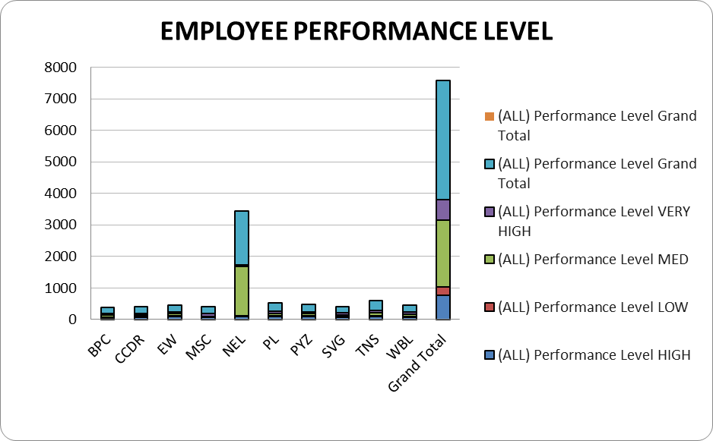
RESULTS
‹#›

Slide 13
Results
The result for this employee performance analysis is that the medium level employees are more in number compared to the high and very high category of employees.

Slide 14
conclusion
The organization should provide necessary training to the employees in the work environment at the medium level. It will lead to the growth and development of the organization. It also improves the skills of the employees.

